Slide 1
Design a system to transfer alternating current in optical fiber using a light-emitting diode
Presented by:
Abdulkareem K. Ali
Hussein A. Akhtar

Slide 2
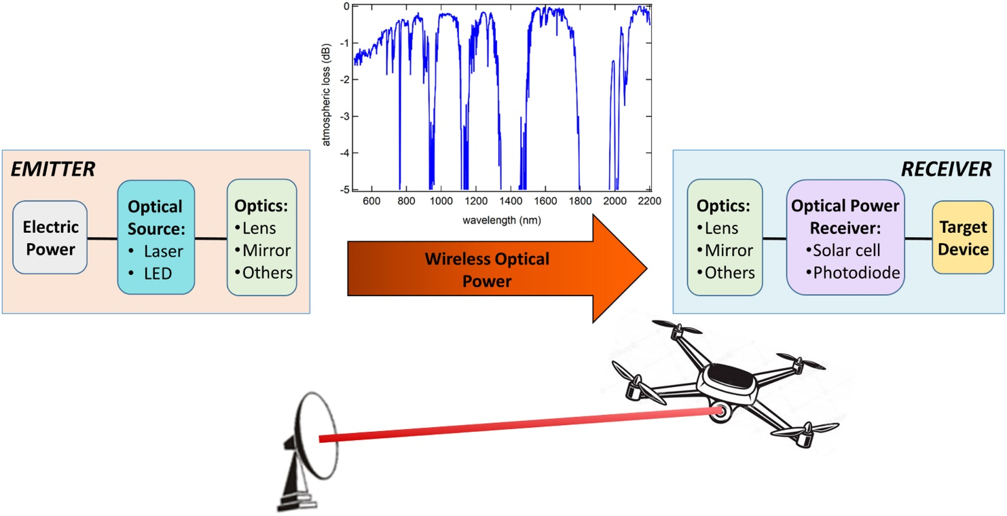
Introduction To Laser power transmission
Laser power transmission (LPT) is one of the most promising technologies in the long-range wireless power transfer field. LPT research has been driven by the desire to remotely power unmanned aerial vehicles (UAVs), satellites, and other mobile electric facilities.

Slide 3
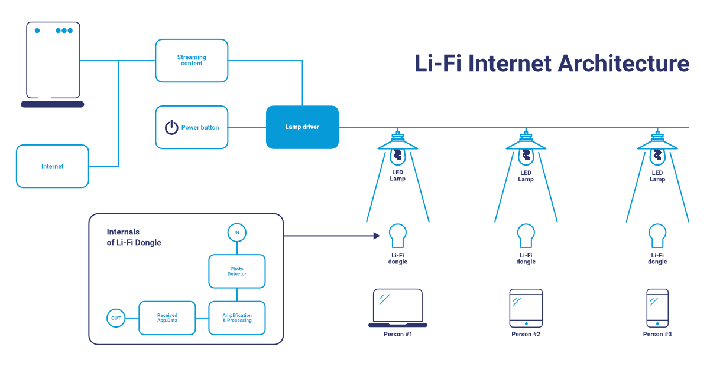
Introduction To LiFi
LiFi is one of the newest communication technologies that aim to improve upon current technology by making use of visible light communication as opposed to the radio waves used by WiFi. Its introduction actually serves a dual purpose as it aims to provide overhead illumination to households as well as facilitate the transfer of data.

Slide 4
Flow of Work (model No.1)
In order to find a new way to transmit the electric current, the li-fi system is used, and instead of entering the data into the system, an alternating electric current is entered so that the electric current is included with the optical wave using the LED.
the transmitter section comprises 3 channels separated. Each channel consists of a light-emitting diode (LED) that modulates an alternating current (AC) signal on the photovoltaic guide to become a pulse LED. Next, the 220 ohm resistor was connected to the positive pin of the three LED's and the positive pin of the vcc was connected to the resistor and then the AC source pins were connected in series between the negative pin of the vcc and the negative pin of the LED.

Slide 5
In receiver section Photoresistor LDR is used for optical to electrical conversion (demodulation).The positive end of the Vcc is connected to one of the ends of the photoresistor, and the other end of the photoresistor is connected to one of the ends of the electrical transformer. Then an electrical resistance of 5.6K ohm is connected with the terminal of the photoresistor, which is connected with the electrical transformer, and the other end of the electrical resistance is connected with the other end of the electrical transformer and with the negative terminal of Vcc.

Slide 6
system design and configuration

Slide 7
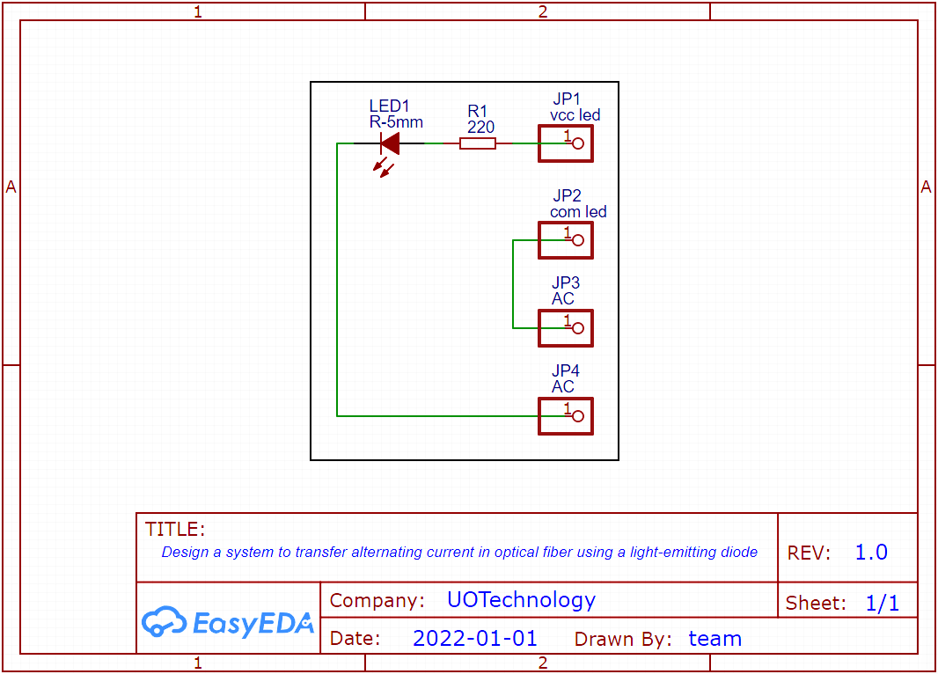
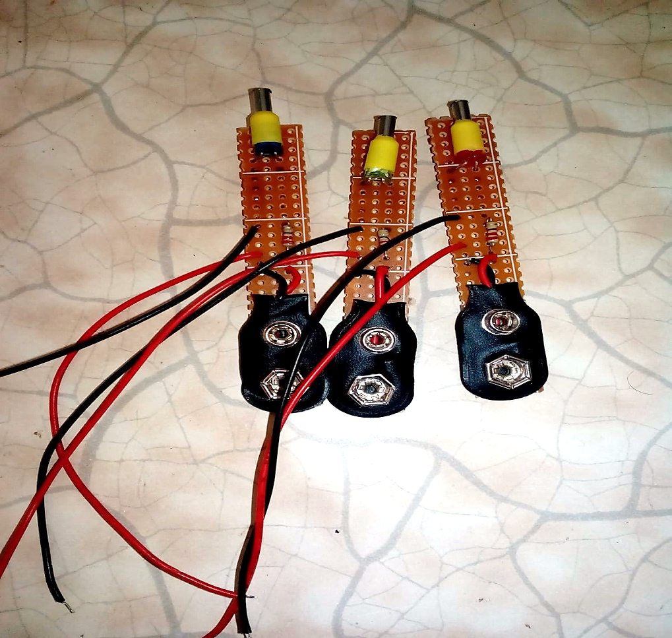
the transmitter circuits

Slide 8
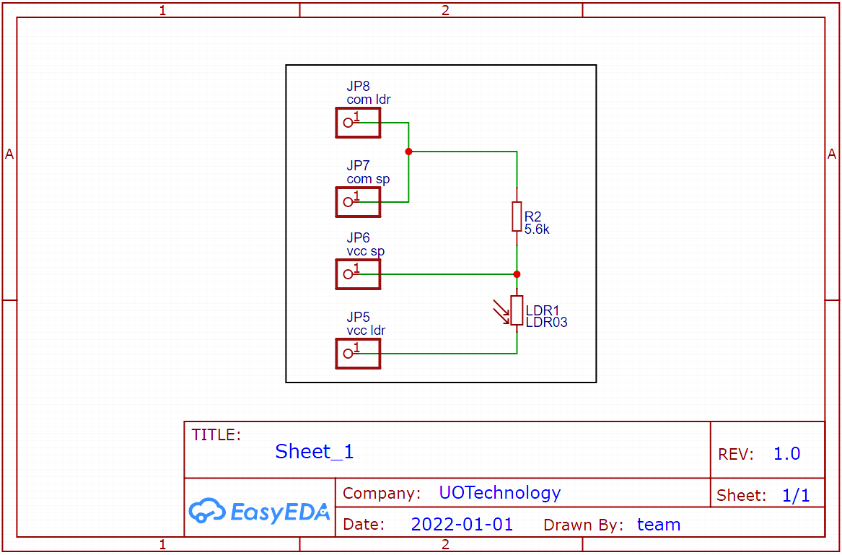
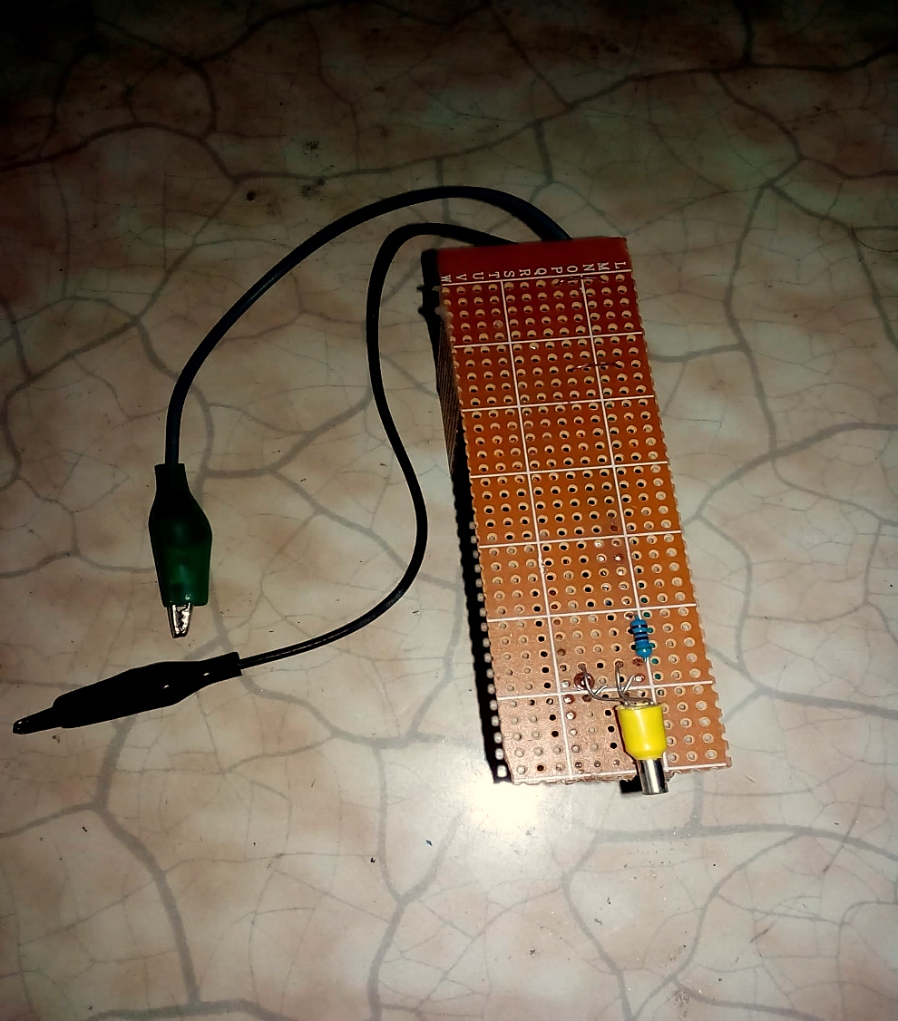
the receiver circuits

Slide 9
Results and discussion

Slide 10
Photon power of LED before AC modulator and after AC modulator

Slide 11
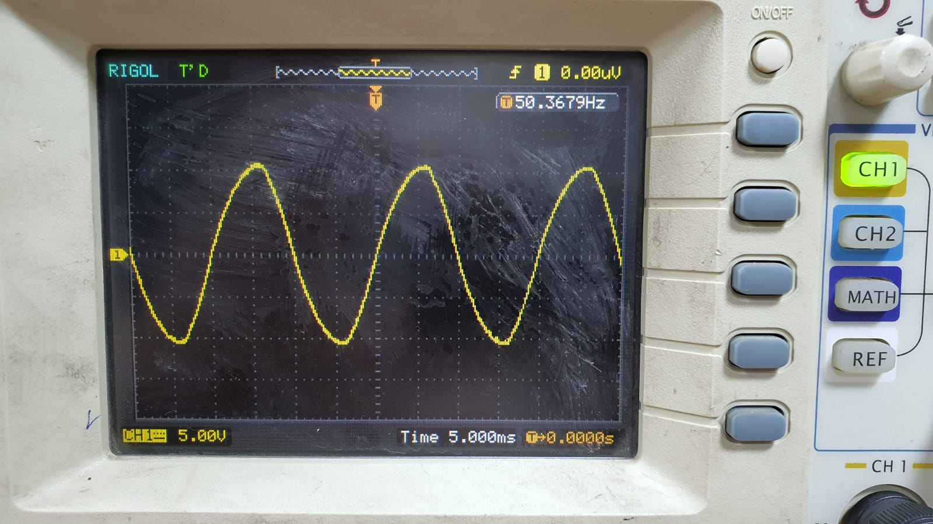
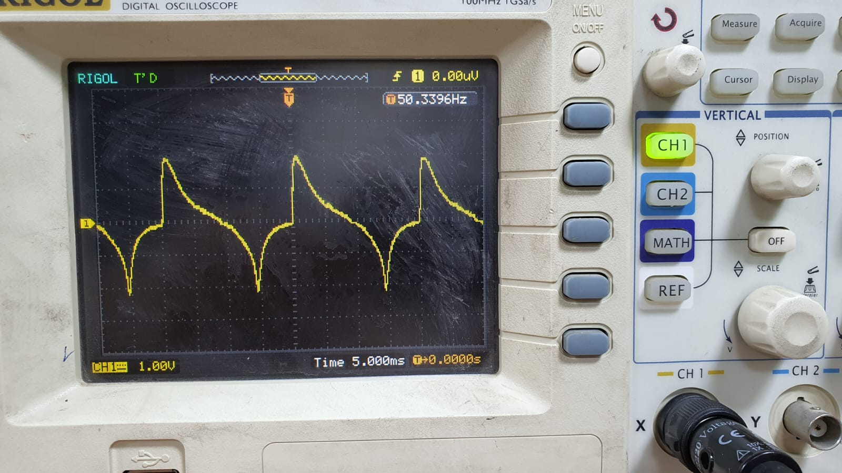
Results of signals using Single-Phase Generator in free space (1)
Input signal
Output signal of red LED

Slide 12
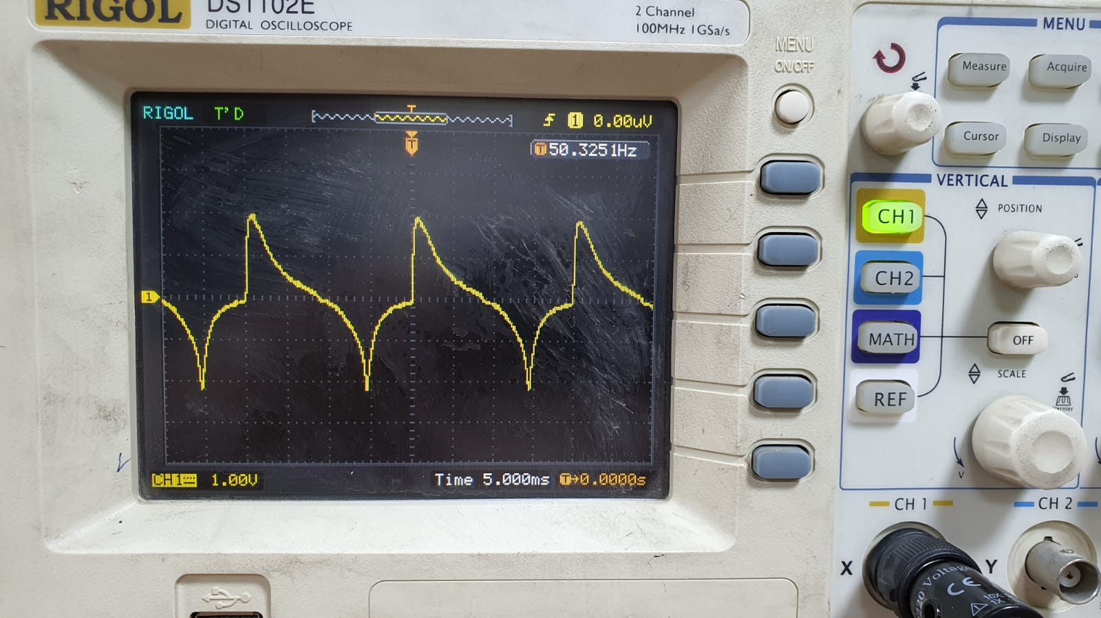
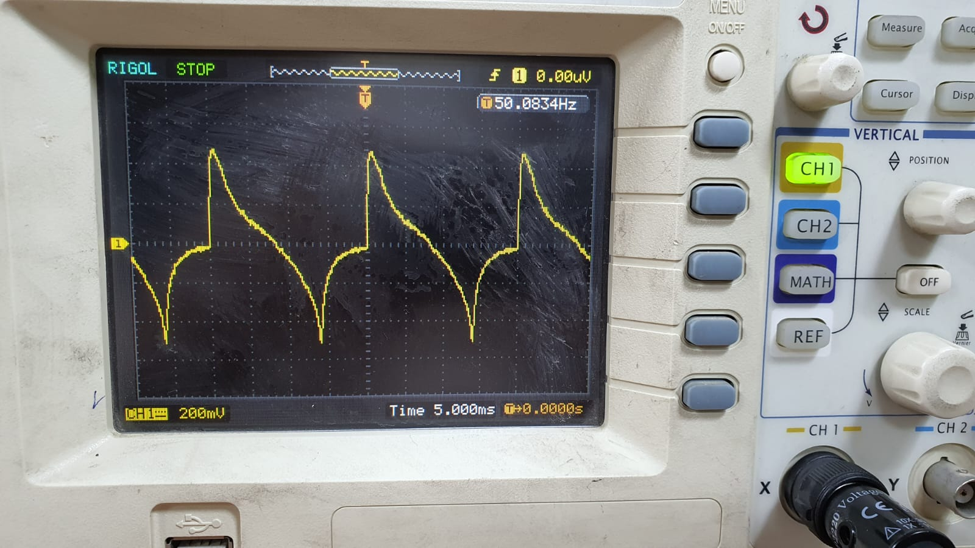
Results of signals using Single-Phase Generator in free space (1)
Output signal of green LED
Output signal of blue LED

Slide 13
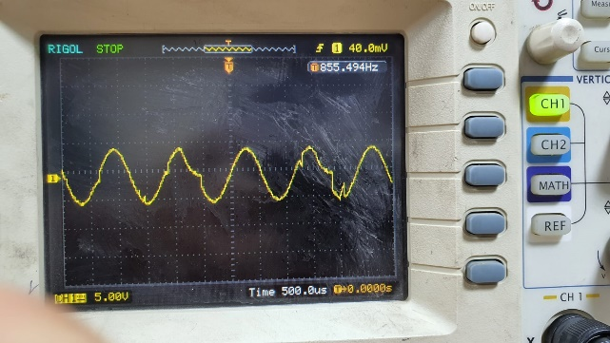
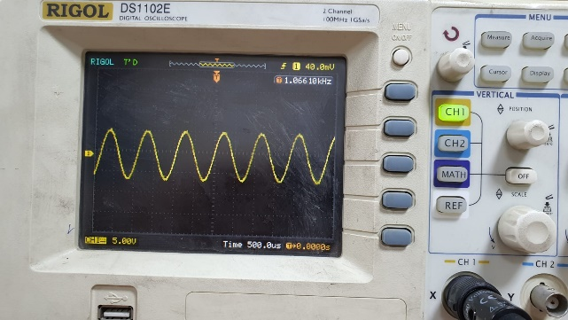
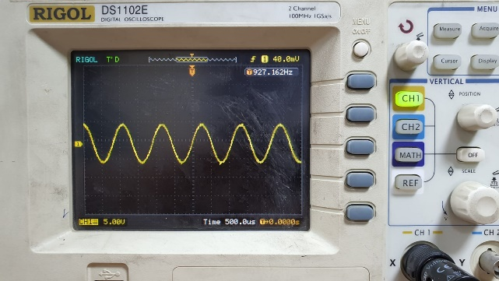
Three-phase input signal
Input signal of red LED
Input signal of green LED
Input signal of blue LED

Slide 14
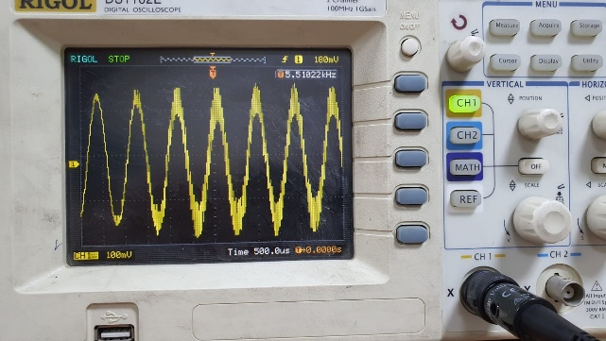
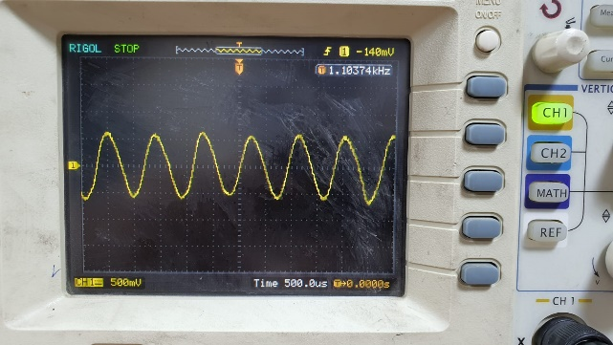
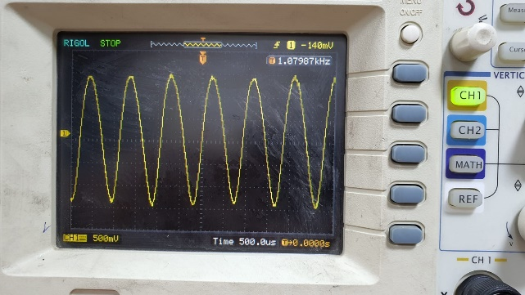
Results of signals using Three-phase input signal in free space (2)
Output signal of red LED
Output signal of green LED
Output signal of blue LED

Slide 15
Photon power of LED with single phase and three-phase in the optical fiber

Slide 16
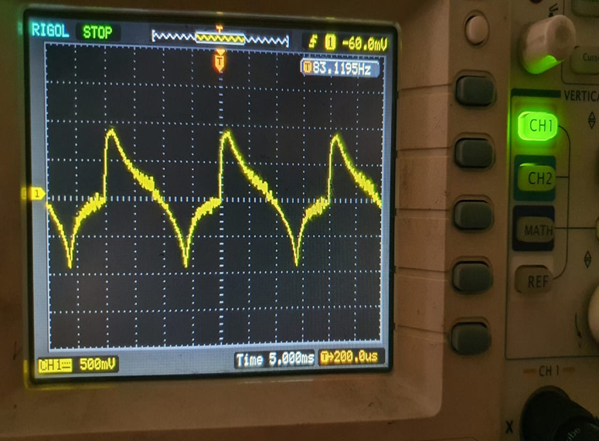
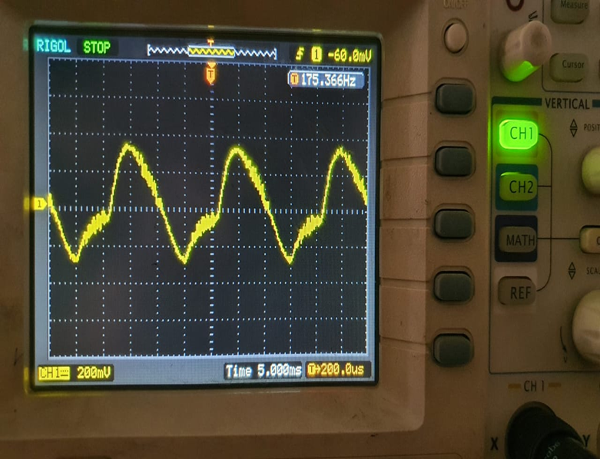
Results of signals using Single-Phase Generator in optical fiber (3)
Output of single phase of green LED
Output of single phase of blue LED

Slide 17
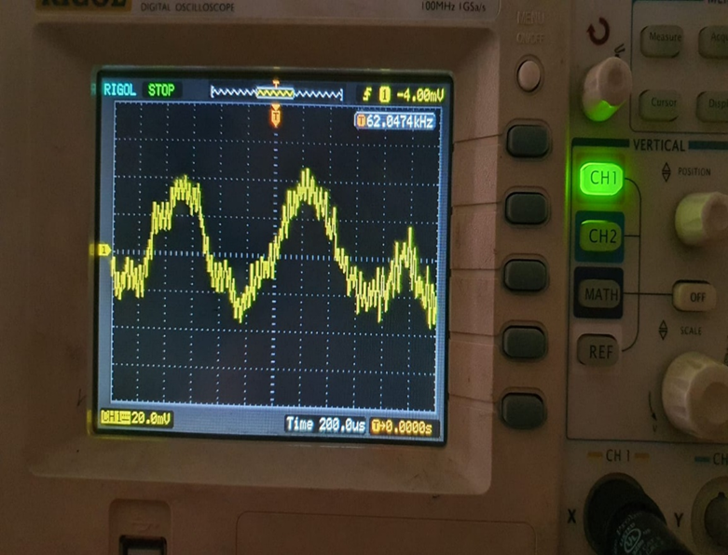
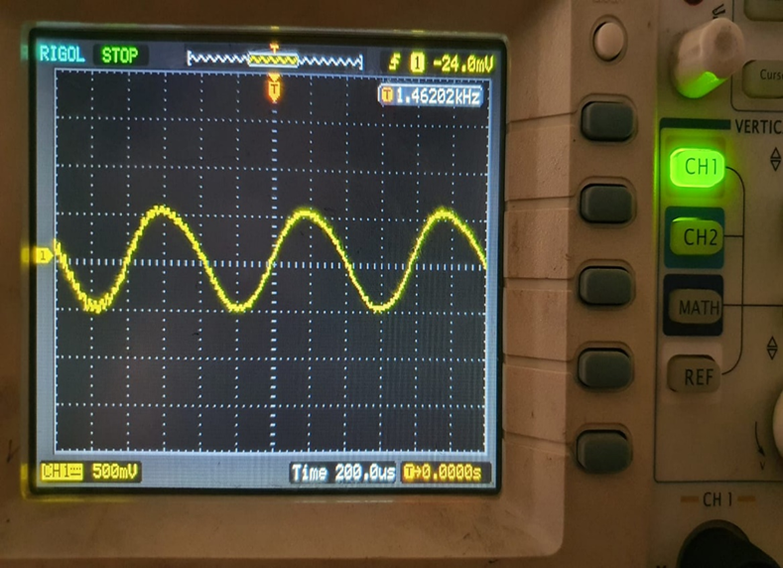
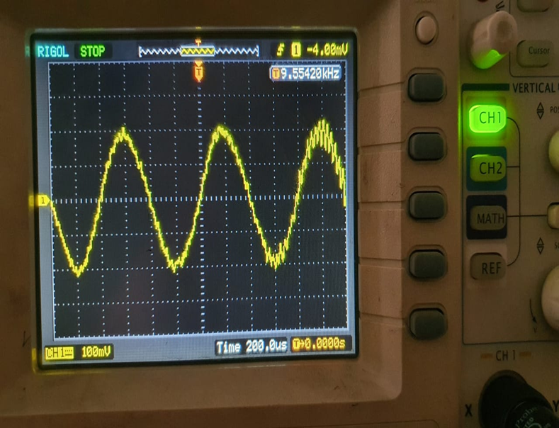
Results of signals using Three-phase input signal in optical fiber (4)
Output of single phase of red LED
Output of single phase of green LED
Output of single phase of blue LED

Slide 18
Signal efficiency in all wavelength
Where this table represents the efficiency of the wavelengths in each method in which the alternating electric current was transmitted

Slide 19
Flow of Work (model No.2)
In order to find a new way to transmit the electric current, the li-fi system is used, and instead of entering the data into the system, an alternating electric current is entered so that the electric current is included with the optical wave using the LED.
the transmitter section comprises 1 channel separated. this channel consists of a light-emitting diode (LED) that modulates an alternating current (AC) signal on the photovoltaic guide to become a pulse LED. Next, the 220 ohm resistor was connected to the positive pin of the three LED's and the positive pin of the vcc was connected to the resistor and then the AC source pins were connected in series between the negative pin of the vcc and the negative pin of the LED.

Slide 20
In the receiving department an LDR photoresistor is used to convert optical to electrical (demodulation).The LDR is connected to the 5.6 k ohm resistor in parallel. And the 3-volt source is connected with the 5.6 k ohm resistor in parallel. And then an amplifying (with 15V vss) device is connected to the router with a resistance of 5.6 k Ohms, and then a crystal capacitor is connected in parallel to the two ends of the amplifier. At the end, the lifting transformer is connected and the output voltage is measured.

Slide 21
system design and configuration (model No.2)

Slide 22
the transmitter circuits

Slide 23
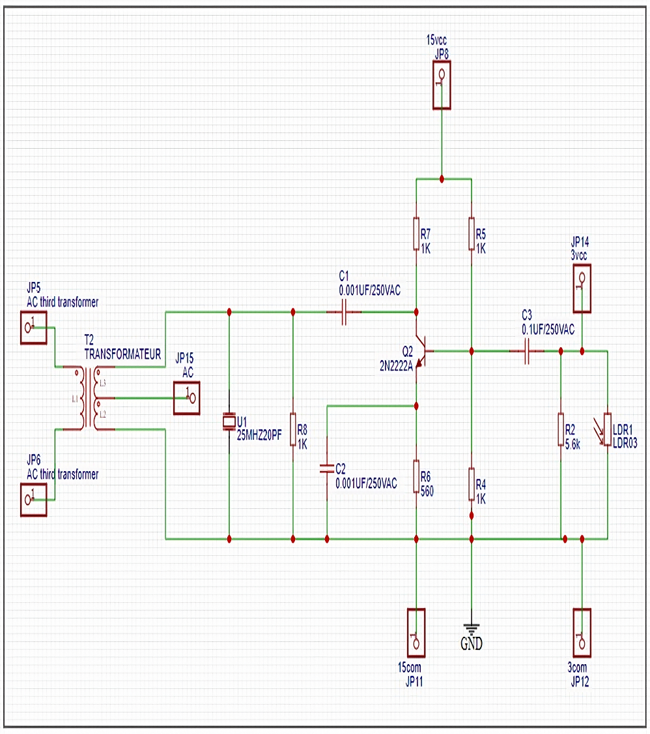
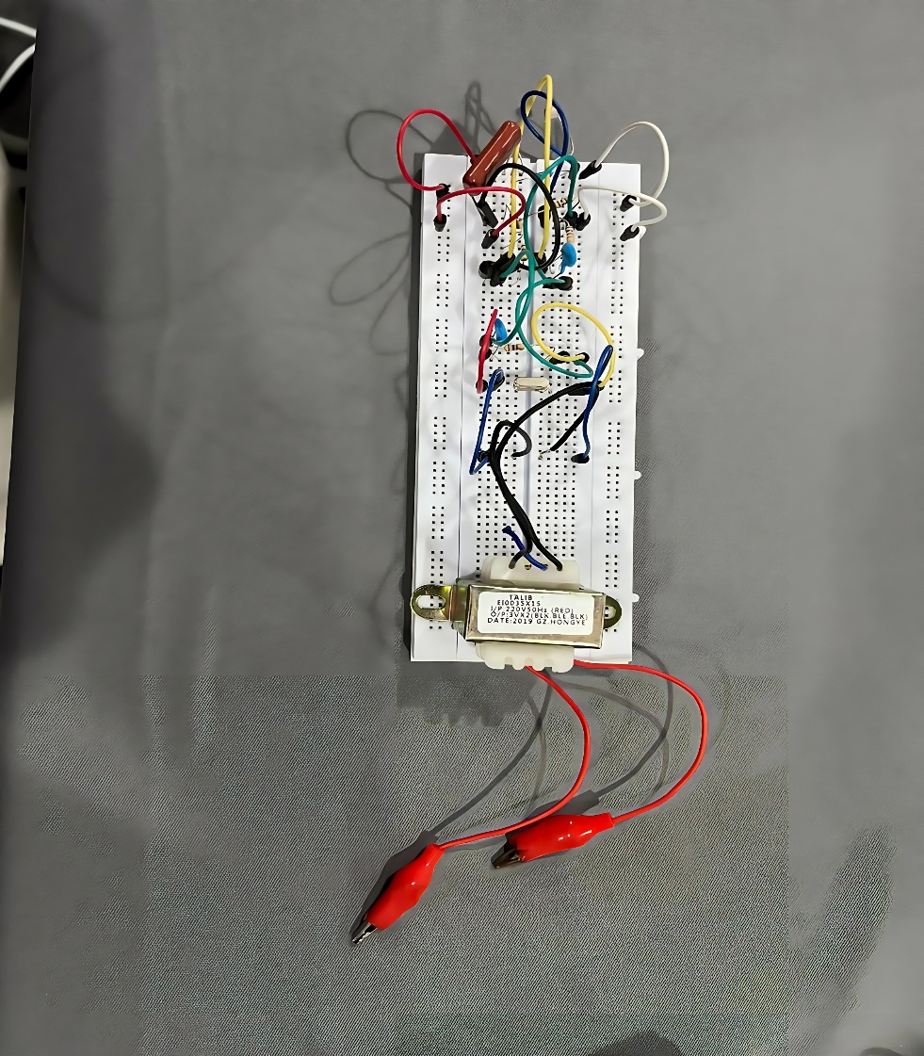
the receiver circuits

Slide 24
Results and discussion

Slide 25
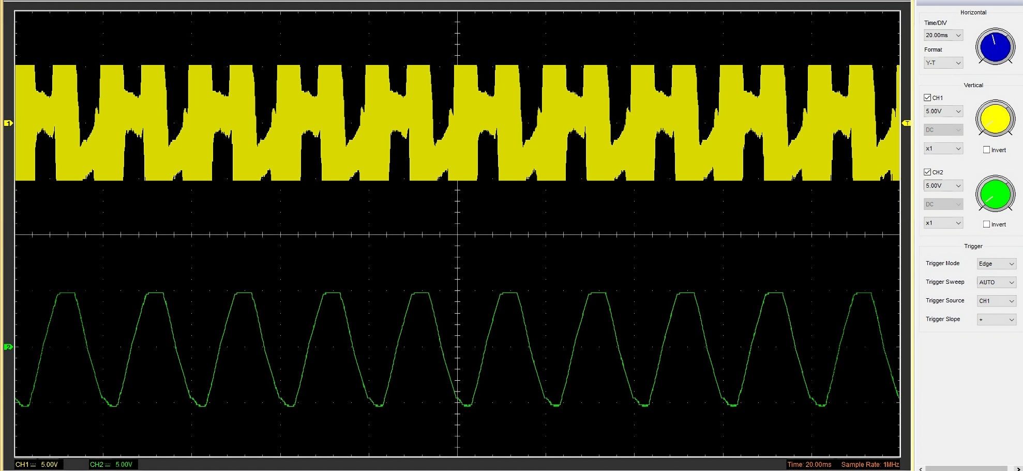
Results of signals using Single-Phase Generator in free space(CH1-output and CH2-input)

Slide 26
Conclusions
It was concluded that signal tramission of blue wavelength has a lower power level compared to green and red light emitting diodes.
The diffeculties of this project is to maintain perfect alignment between the LEDs and the plastic optical fiber.
Further, more signal loss is found due to waste of signal power due to coupling loss.
a number of advantages were concluded which they are: low cost design, simple circuit implementation, and suitable controlling of the circuit.

Slide 27
Thank you

